Slide 1

A Secure and User-Friendly Voting System
This presentation will showcase the design and functionality of a secure and user-friendly voting system, built using Java and MySQL.
Developed By
HARINI S 231801049 B.tech -Artificial Intelligence and Data Science

Slide 2
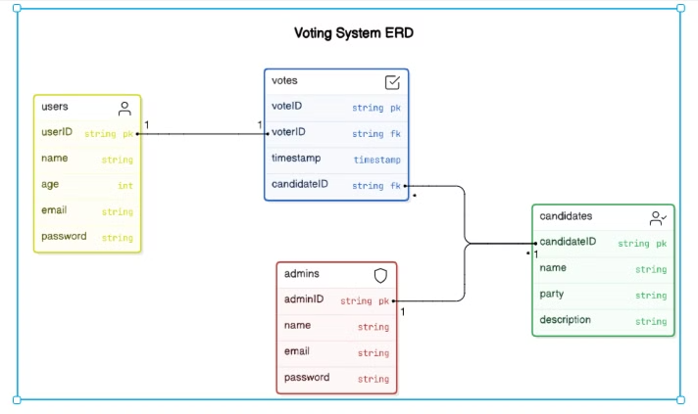
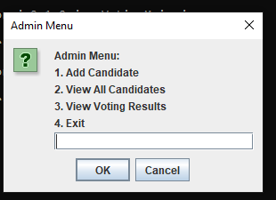
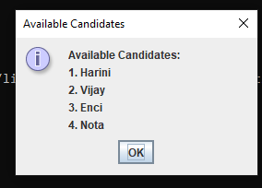
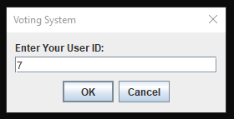
Project Overview
Purpose
Key Features
Designed to streamline elections, allowing users to vote for candidates and administrators to manage the process.
Secure user authentication, real-time vote tracking, and a user-friendly interface.

Slide 3

Technologies Used
Java
MySQL
The core programming language for front-end development and logic.
The relational database management system used to store and manage data.
JDBC
The Java API used to connect and interact with the MySQL database.

Slide 4
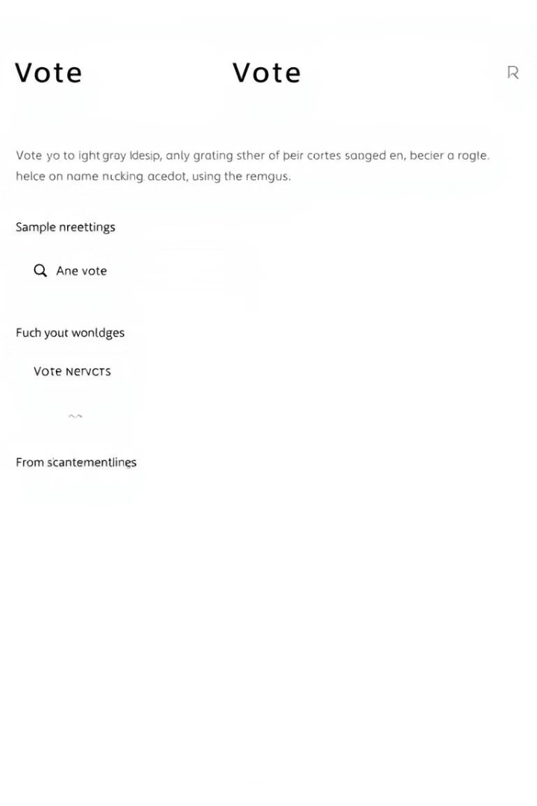
User Interface and Functionality
1
Registration and Login
2
Candidate Selection
View a list of candidates and their information.
Users register using unique IDs and passwords.
3
Vote Casting
4
Real-time Results
Users can easily select their preferred candidate.
View the latest vote count for each candidate.

Slide 5
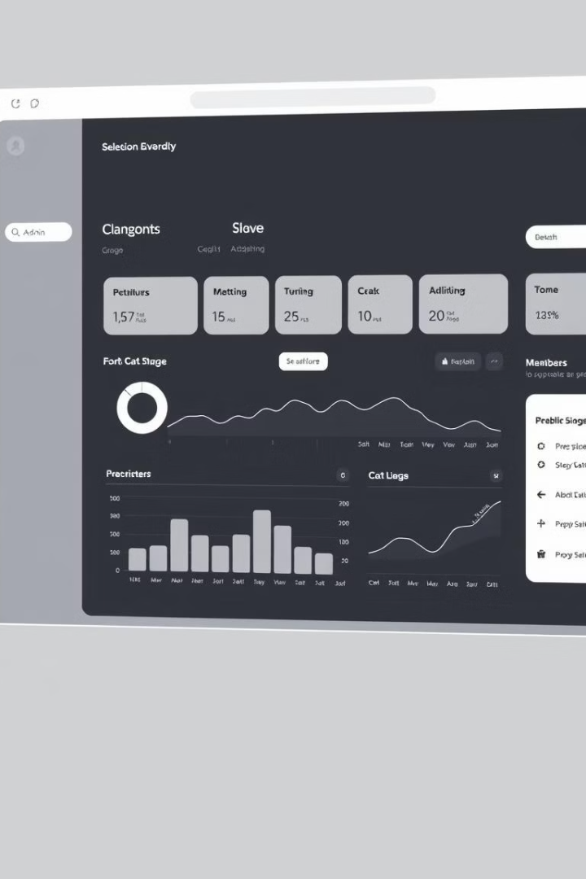



Admin Interface and Security
User Management
Admins can manage user accounts and access.
Candidate Management
Admins can add, edit, and delete candidates.
Data Security
The system prevents duplicate voting and SQL injection.

Slide 6

Implementation Details
Database Design
Testing and Deployment
Create tables to store user, candidate, and vote data.
Thoroughly test the system and deploy it for use.
1
2
3
Java Logic
Develop the front-end interface and backend logic for voting.

Slide 7
Future Enhancements
Email Integration
1
Send vote confirmations, reminders, and election results.
Advanced Admin Panel
2
Provide more detailed reports and data analysis tools.
Enhanced Security
3
Implement two-factor authentication and encrypted data storage.

Slide 8

Conclusion
This secure and user-friendly voting system offers a valuable tool for managing elections efficiently and transparently. Its intuitive design and advanced features make it a reliable solution for various voting scenarios.

